Slide 1
PsLove dataset analyzation
Winter Coders

Slide 2
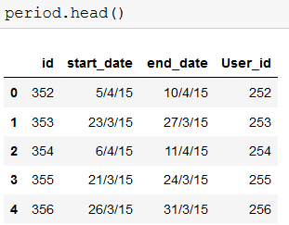


➔ Given Data
1) User Data(id,cycle_length_initial,period_length_initial) 2) Period() 3) Symptoms

Slide 3
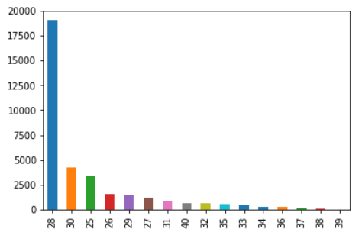
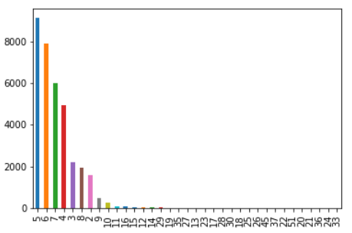
Plots
Excepted Cycle Length Initial ➔ Excepted Period Length Initial

Slide 4
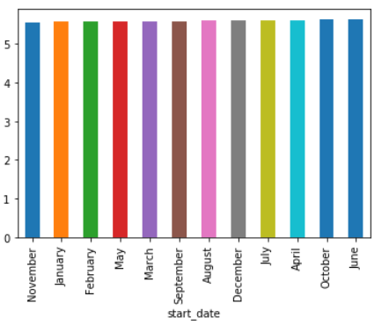
Plots
Monthly period lengths

Slide 5

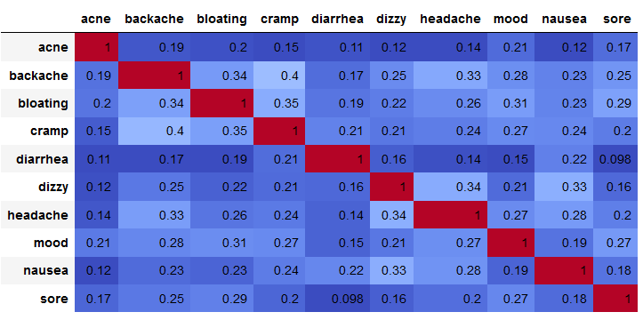
Most common occurring Symptoms
PCA(variance ratio)
Correlation On Symptoms

Slide 6
symptoms
Based on Correlation matrix and PCA
We can represent entire data using 3 axises

Slide 7
Proposed Method
Collect pre-period data (backache,etc…)
based on seviourness of the symptoms from pre-period data we might be able to predict the number of days before next period.

